Slide 1
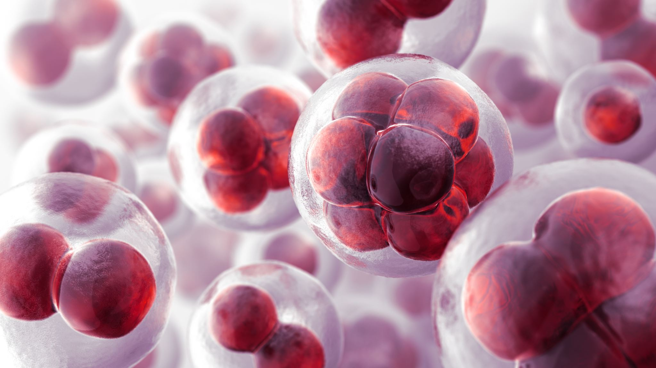
Malaria Detection from blood smear images using Deep Learning Models
Presented by:
Karan Sachdeva - x18185916
Vishal Goyal - x18180540
Terrance Thomas - x18184928
Ankish Kumar Chandani - x18189245

Slide 2
Points covered in the presentation
Motivation
Research Question
Dataset
Methodology
Data preparation
Model used
Results
Limitations
Conclusion and future work

Slide 3

Motivation
One of the most tragic disease
Major cause of concern for many countries
Traditional method takes more time

Slide 4
Research Questions
To what extent Deep Learning can be used to diagnose Malaria from blood smear images ?

Slide 5
Dataset
Data source: https://www.kaggle.com/kmader/malaria-bounding-boxes
1328 images used
2 classes of cells: RBC and Leukocytes
4 classes of infected cells: Gametocytes, Rings, Trophozoites, and Schizonts
Highly imbalanced

Slide 6
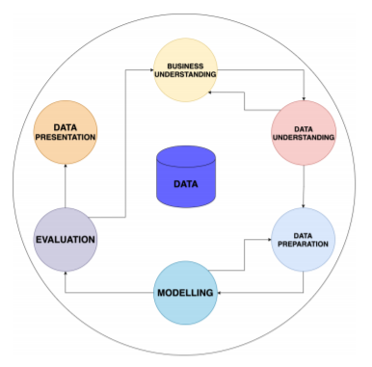
Methodology

Slide 7
Data preparation
Images were split into two parts viz Train and Test
Images were resized to 280, 280 for the image classification
Images were cropped to a circle form
All images were angled differently to make a count of 4075 images
Images were transformed to grayscale, and Gaussian Blur to overcome background colour issue

Slide 8
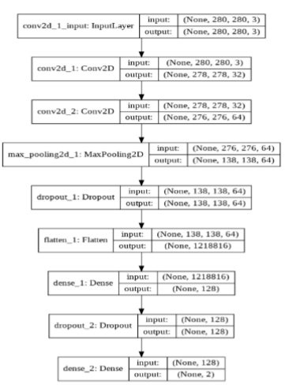

Model used
Convolutional Neural Network (CNN) classification
CNN model of 9 layers was implemented

Slide 9
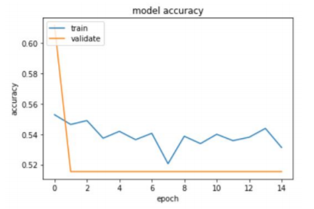
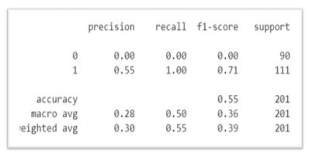
Results

Slide 10
Limitations
Biased Model
Difference in the resolution of images
Huge image size

Slide 11
Conclusion and future work
Classification of smear images into infected and uninfected could be targeted in future with increased interest
Train model on larger dataset of images
Use of bounding box
Use of Resnet-50 and faster RCNN models
Use of object detection model such as YOLO

